Slide 1
Deep Neural Networks
(AIML ZG511)

Slide 2
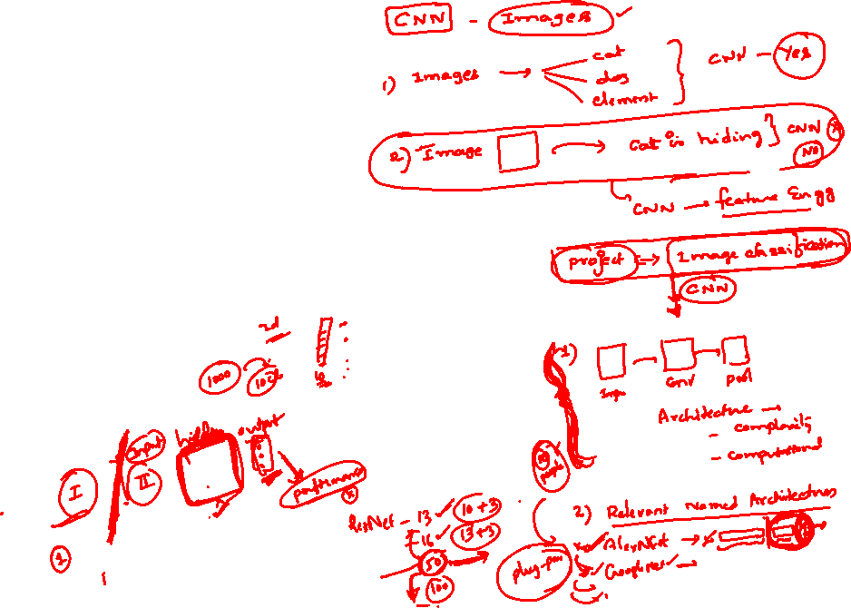
MODULE # 7 :
RNN
Session 10
(12th July 2026)

Slide 3
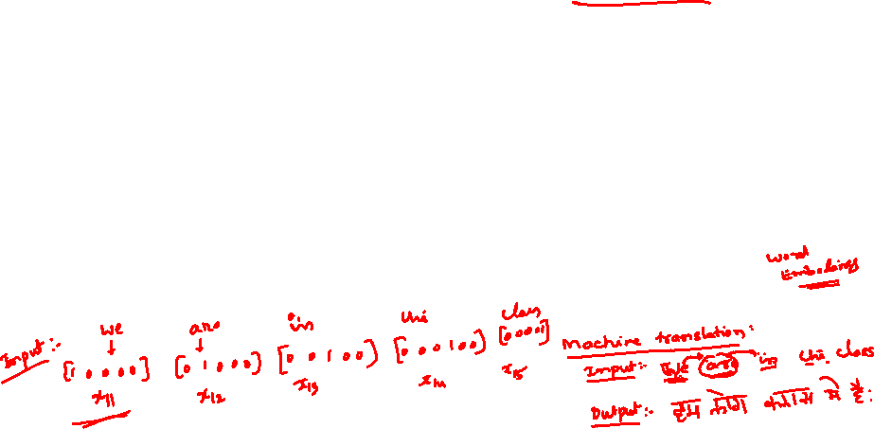
Example: Auto-completion
This is not true in many applications.
The size of the input is not always fixed.
Successive inputs may not be independent of each other.
Each network (blue - orange - green structure) is performing the same task –
input : character
output : character.
Example: Auto-completion.
e e
p
eow
d
e e
p

Slide 4
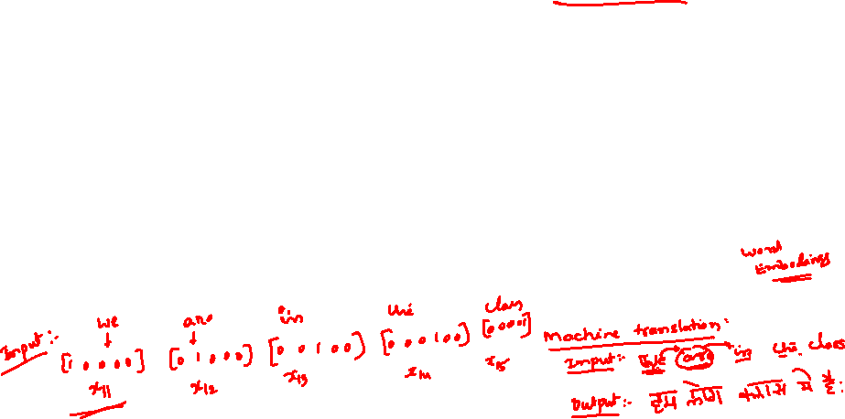
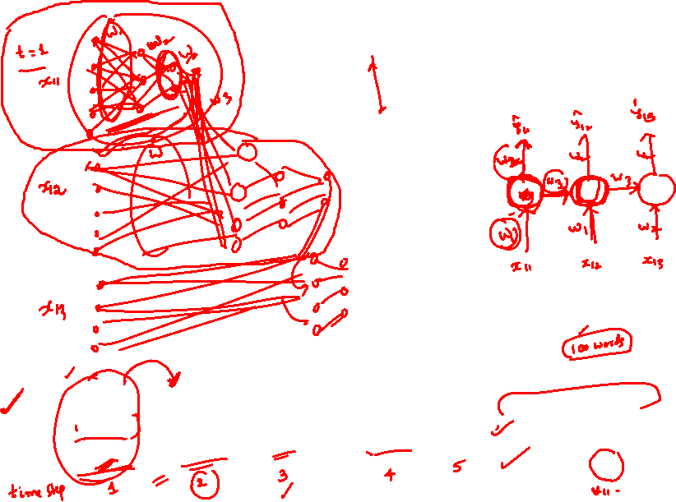
Example: Auto-completion

Slide 5
Part of Speech Tagging
Task is predicting the part of speech tag (noun, adverb, adjective, verb) of each word in a sentence.
When we see an adjective we are almost sure, the next word should be a noun.
The current output depends on the current input as well as the previous input.
The size of the input is not fixed. Sentences have any number of words.
An output is produced at end of each time step.
Each network is performing the same task – input : word, output : tag.
noun
verb
article adj
noun
Apple is a
red fruit

Slide 6
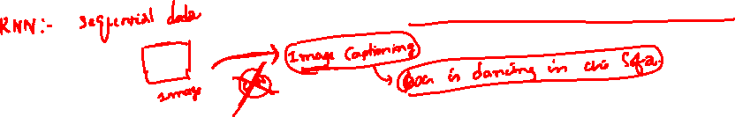
Sentiment Analysis
Task is predicting the sentiment of a whole sentence.
Input is the entire sequence of inputs.
An output is not produced at end of each time step.
Each network is performing the same task –
input : word,
output : polarity +/−.
(-)
The movie was
boring and
long

Slide 7
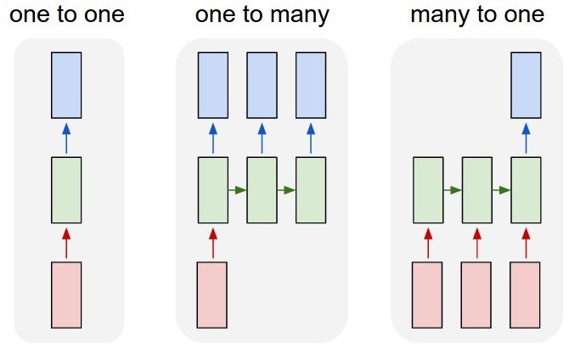
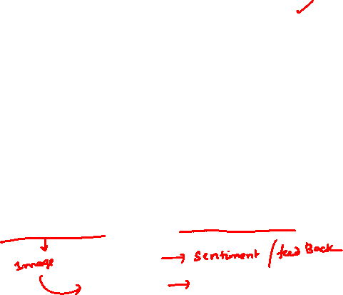
Types of RNN
Courtesy: Andrej Karpathy

Slide 8
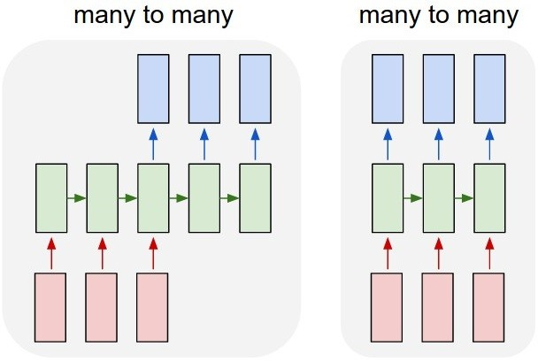
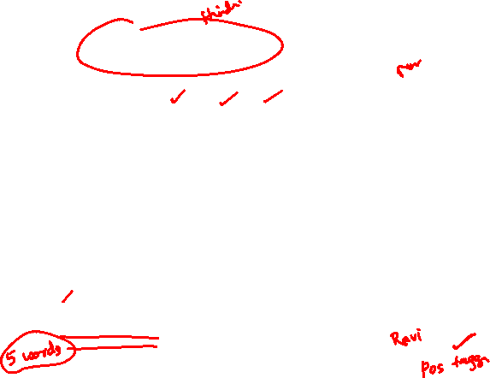
Types of RNN
Courtesy: Andrej Karpathy

Slide 9
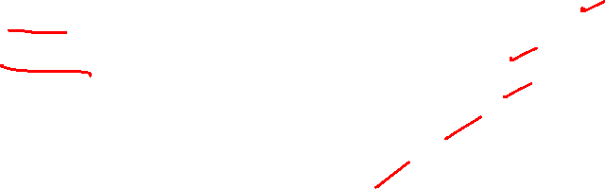
Types of RNN and Applications
One to one – Generic neural network, Image classification
One to many – Music generation, Image Captioning
Many to one – Movie review or Sentiment Analysis
Many to many – Machine translation Synced
Many to many – Video classification

Slide 10


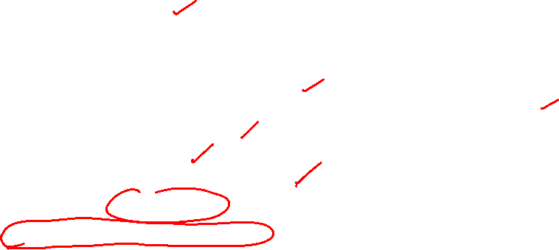
Motivation: Why Sequence Models?
Many real-world problems involve sequential data:
⁾ Natural Language: ”The cat sat on the ”
⁾ Time Series Forecasting: Stock prices, temperature prediction, sensor data
⁾ Speech: Audio signals over time
⁾ Video: Frame sequences
⁾ Genomics: DNA/protein sequences Key
characteristics: Order matters
Dependencies exist across time steps
The
Cat sat ^{on}
the
?
Dependencies

Slide 11
Why Feedforward Networks Fail?
Key issues:
⁾ Fixed input size: Cannot handle variable-length sequences
⁾ No memory: Each input processed independently
⁾ No parameter sharing: Different weights for each position
Example Problem: Predict next word in a sentence
⁾ Input: ”I grew up in France, so I speak fluent ”
⁾ Need context from 7 words back (”France”) to predict ”French”
⁾ Feedforward network treats each position independently
We need: A model that can remember past information

Slide 12
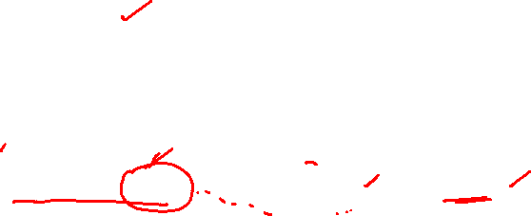
Temporal Dependencies
Short-term dependencies: Information needed is recent
⁾ ”The clouds are in the ” → ”sky”
Long-term dependencies: Information needed is far back
⁾ ”I grew up in France... I speak fluent ” → ”French”
Challenge: Model must learn to remember relevant information and forget irrelevant information.
Different sequence lengths require flexible architectures

Slide 13
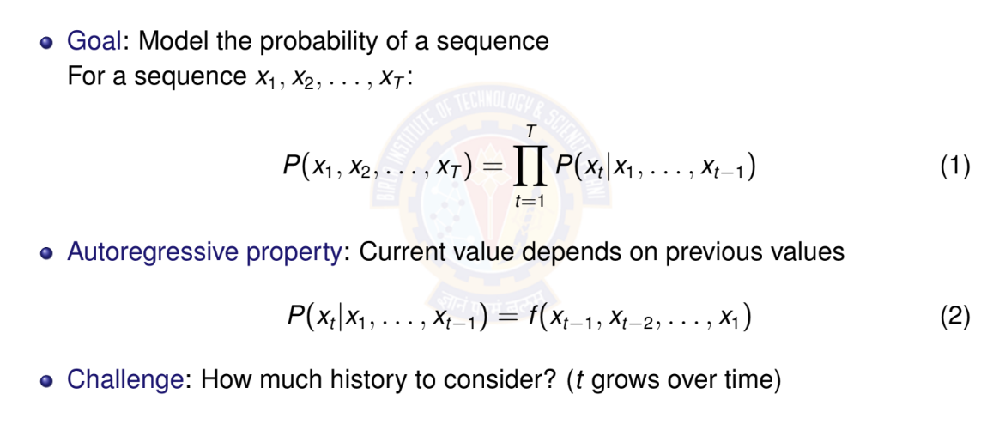
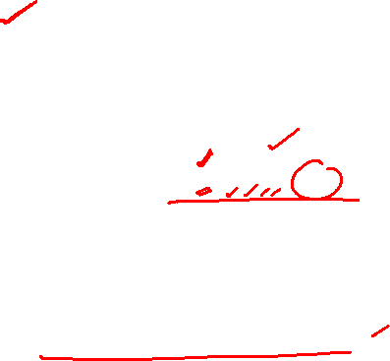
Autoregressive Models

Slide 14
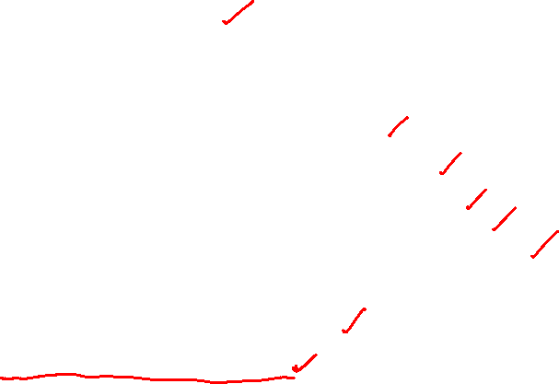
Autoregressive Models: Example
Sequence: ”The cat sat on the”
Predict: Next word (e.g., ”mat”)
Autoregressive decomposition:
P (The, cat, sat, on, the, mat) = P(The)
× P(cat|The)
× P(sat|The, cat)
× P(on|The, cat, sat)
× P(the|The, cat, sat, on)
× P(mat|The, cat, sat, on, the)
Each word depends on ALL previous words
History grows with sequence length

Slide 15
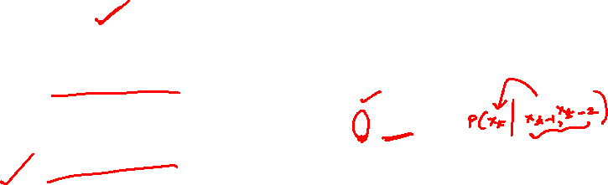
Markov Assumption
Simplification: Limit the context window
First-order Markov: Only immediate past matters
P(x_{t} |x₁, . . . , x_{t —1}) ≈ P(x_{t} |x_{t —1})
(3)
k -th order Markov: Last k steps matter
P(x_{t} |x₁, . . . , x_{t —1}) ≈ P(x_{t} |x_{t —k} , . . . , x_{t —1})
(4)
Advantage: Fixed-size context, tractable computation
Disadvantage: May lose important long-term dependencies

Slide 16
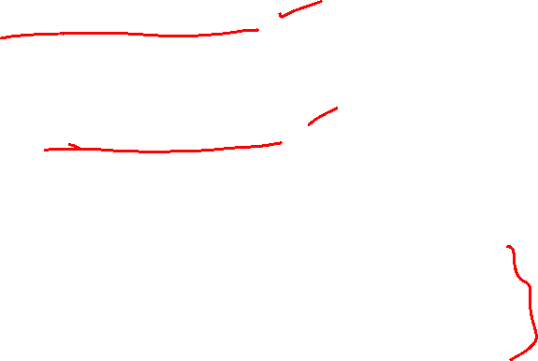
Markov Assumption: Example
Sequence: ”The cat sat on the”
Predict: Next word (e.g., ”mat”)
First-order Markov (bigram):
P(mat|The, cat, sat, on, the) ≈ P(mat|the)
Second-order Markov (trigram):
P(mat|The, cat, sat, on, the) ≈ P(mat|on, the)
Key insight:
Fixed context window (1 or 2 words)
Ignores earlier words like ”cat” and ”sat”
Computationally efficient but limited expressiveness

Slide 17
Latent Variable Models
Alternative approach: Summarize past with a hidden state
h_{t} = f (x_{t} , h_{t —1})
P(x_{t} |x₁, . . . , x_{t —1}) = P(x_{t} |h_{t} )
(5)
(6)
Key insight:
h_{t} is a latent (hidden) variable
Contains compressed summary of history
Fixed-size representation regardless of sequence length
Updated recursively at each time step
This is the foundation of RNNs!

Slide 18
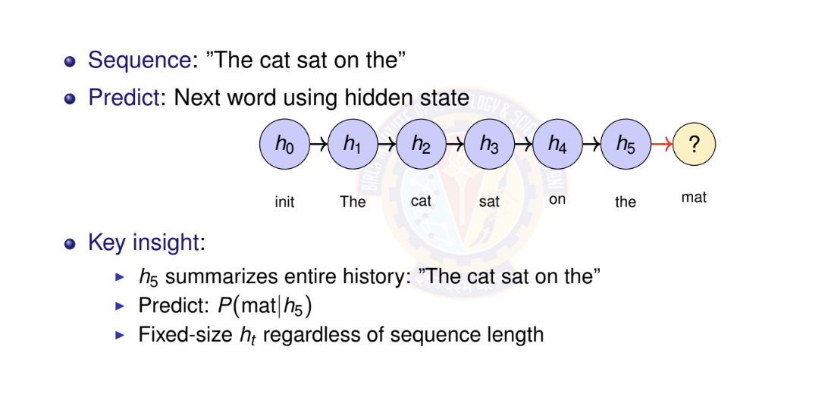
Latent Variable Models: Example

Slide 19
Numerical Example: Temperature Forecasting - Setup
Task: Predict tomorrow’s temperature (regression)
Observed sequence: 20◦C, 22◦C, 25◦C, 24◦C, 21◦C
Approach 1: Autoregressive (First-order)
Linear relationship learned from data:
T_{t +1} = α · T_{t} + β
From historical data, we learned:
α = 0.8, β = 4.0
Example: If today is 25◦C:
T_{tomorrow} = 0.8 × 25 + 4.0 = 24.0◦C

Slide 20
Temperature Forecasting - Autoregressive Prediction
Sequence: 20◦C, 22◦C, 25◦C, 24◦C, 21◦C
Model: T_{t +1} = 0.8 · T_{t} + 4.0
Predict next day (day 6):
Last observation: T₅ = 21◦C
Prediction: T₆ = 0.8 × 21 + 4.0 = 20.8◦C
Multi-step ahead (day 7, using predicted T₆):
T₇ = 0.8 × 20.8 + 4.0 = 20.64◦C
Limitation: Only uses immediate past
Cannot capture weekly/seasonal patterns
Error accumulates in multi-step predictions

Slide 21
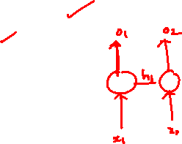
Recurrent Neural Network (RNN)
Definition
Neural network with loops, allowing information to persist
Key idea:
Process sequential data one step at a time
Maintain hidden state that summarizes past information
Same parameters shared across all time steps
The loop: Hidden state h_{t} feeds back into itself at next time step
o_{t}
h_{t}
RNN
Recurrent connection
x_{t}

Slide 22
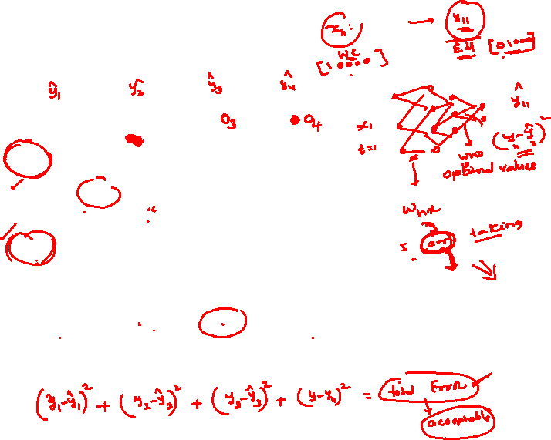
RNN: Unrolled Computation Graph
Unrolling: Visualize RNN across time steps
o₁ o₂ o₃ o₄
same W_{ho}
same W_{ho}
same W_{ho}
same W_{ho}
h₁
same W_{hh}
h₂
same W_{hh}
h₃
same W_{hh}
h₄ · · ·
same W_{hx}
same W_{hx}
same W_{hx}
same W_{hx}
x₁
t = 1
x₂
t = 2
x₃
t = 3
x₄
t = 4
Key insight: Same parameters (W_{hx} , W_{hh}, W_{ho} ) applied at each time step

Slide 23
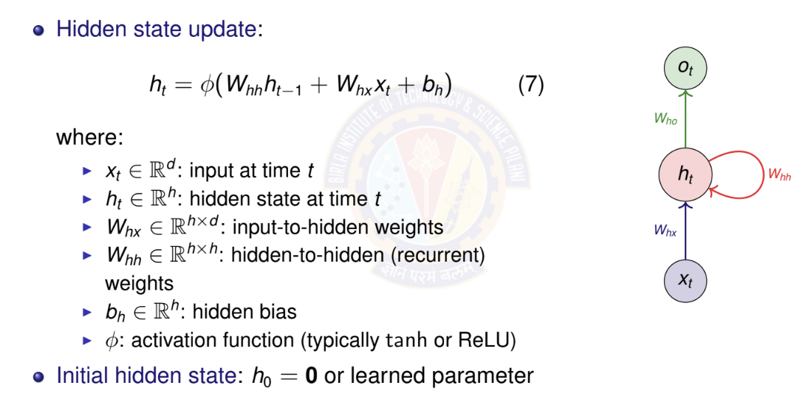
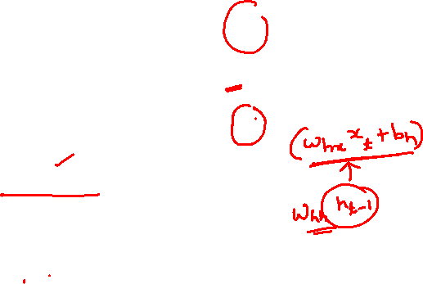
RNN Mathematical Formulation I

Slide 24
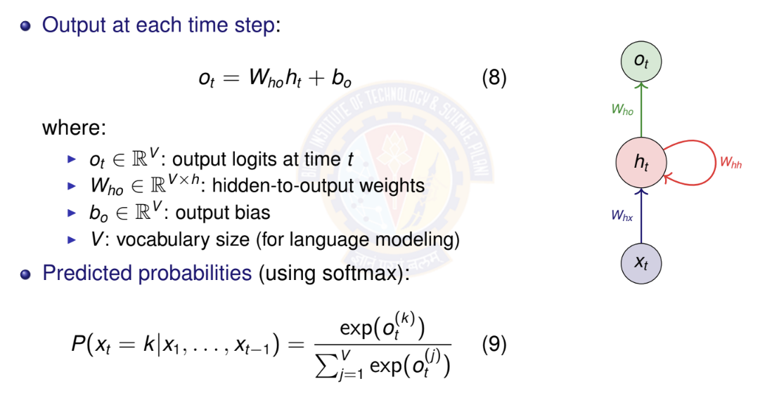
RNN Mathematical Formulation II

Slide 25
Parameter Sharing Across Time
Key insight: Same parameters used at every time step
W_{hx} , W_{hh} , b_{h} : Shared across all time steps
W_{ho} , b_{o} : Shared across all time steps
Advantages:
Fixed number of parameters regardless of sequence length
Can process sequences of any length
Generalization: patterns learned at one position transfer to others
Contrast with feedforward: Different weights for each position

Slide 26
RNN Parameter Counting
Given:
Input dimension: d
Hidden dimension: h
Output/vocabulary size: V
Parameter count:
W_{hx} : h × d W_{hh} : h × h
b_{h} : h
W_{ho} : V × h b_{o} : V
Total : hd + h² + h + Vh + V = h(d + h + V + 1) + V

Slide 27
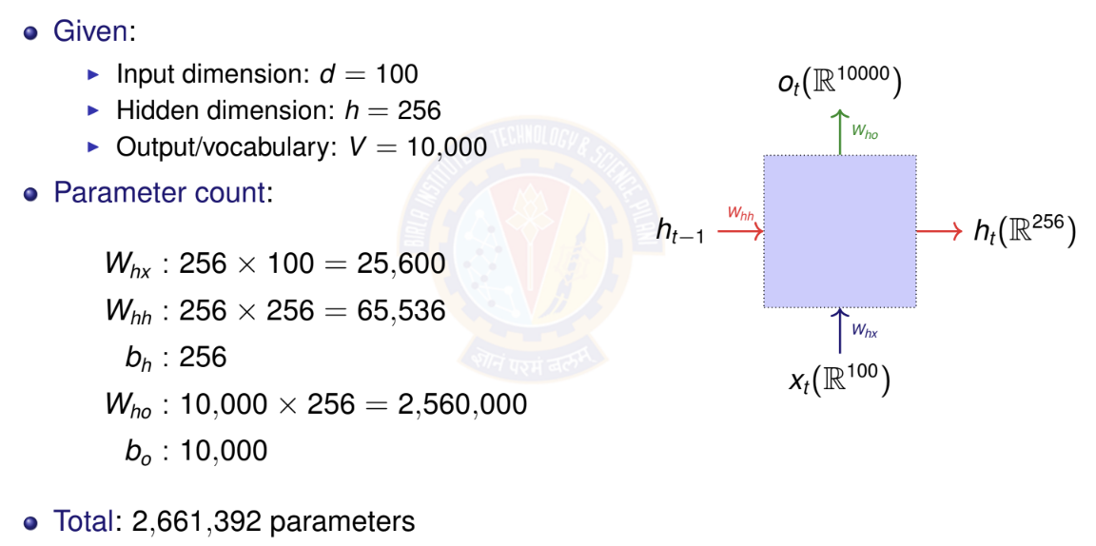
RNN Parameter Counting Example

Slide 28
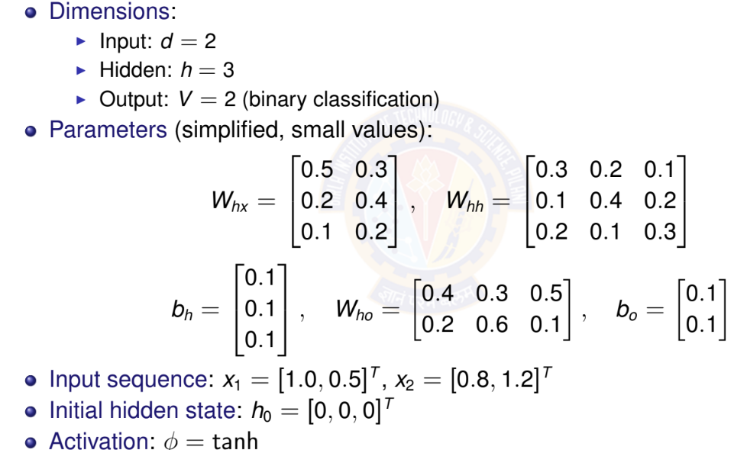
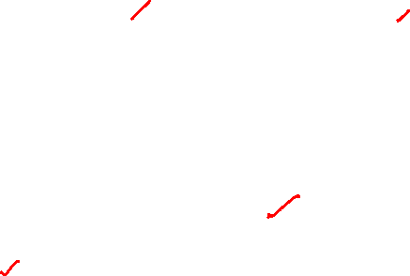
RNN Forward Pass: Simple Example

Slide 29
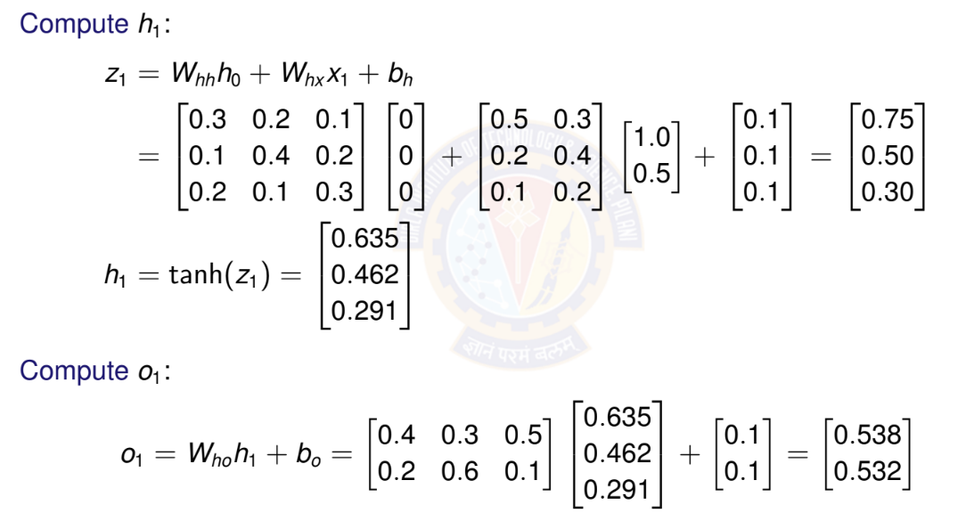
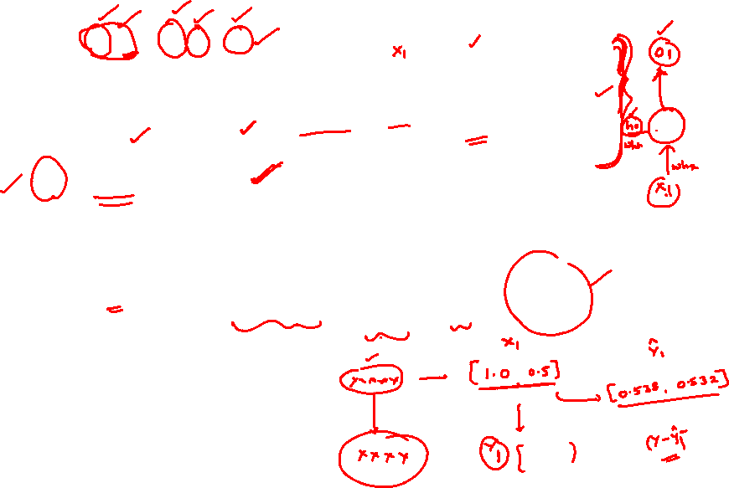
RNN Forward Pass: Time Step t = 1

Slide 30
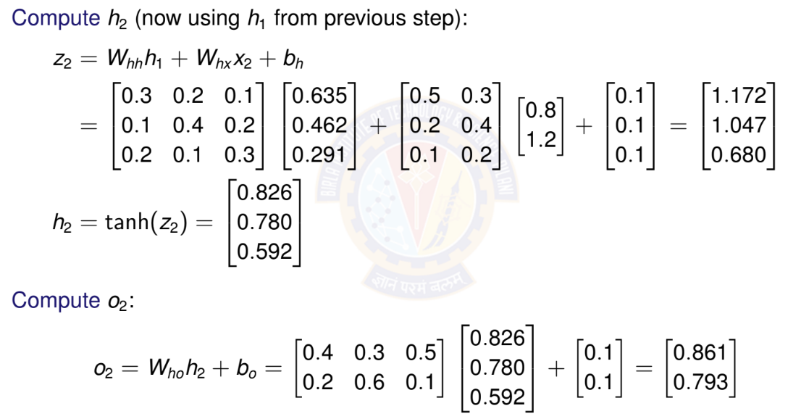
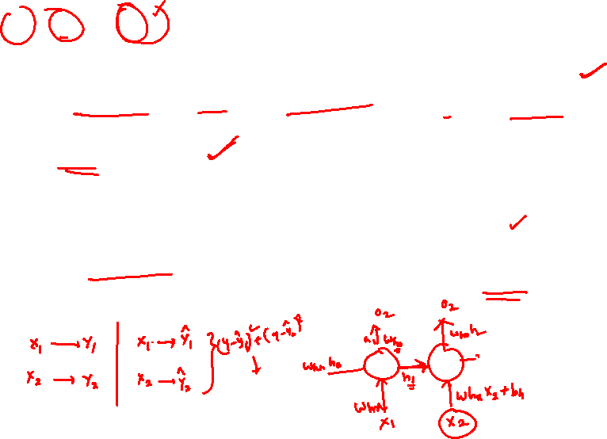
RNN Forward Pass: Time Step t = 2

Slide 31
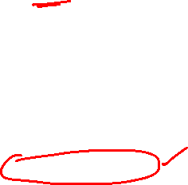
Activation Functions in RNNs
Common choices for φ:
Hyperbolic tangent (tanh):
Range: [−1, 1]
Centered at zero (helps with gradient flow)
Most common for vanilla RNNs
ReLU:
Range: [0, ∞)
Can help with vanishing gradient
May cause exploding activations

Slide 32
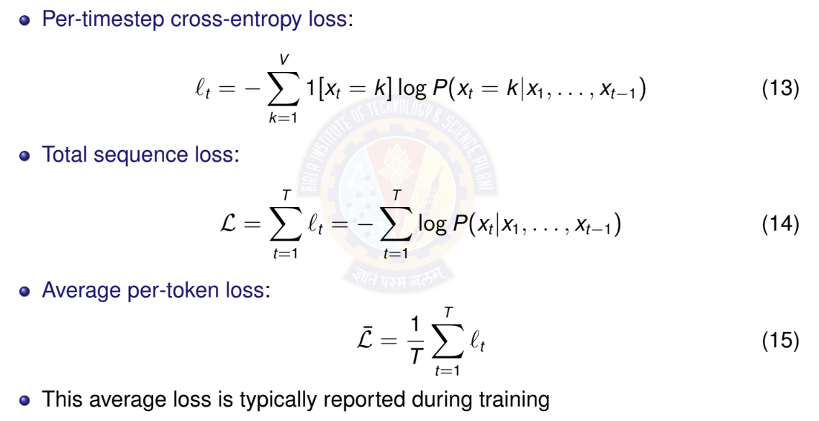
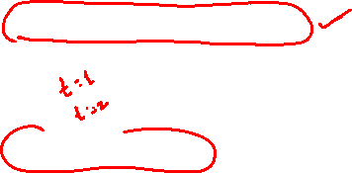
Loss Function for Sequences

Slide 33
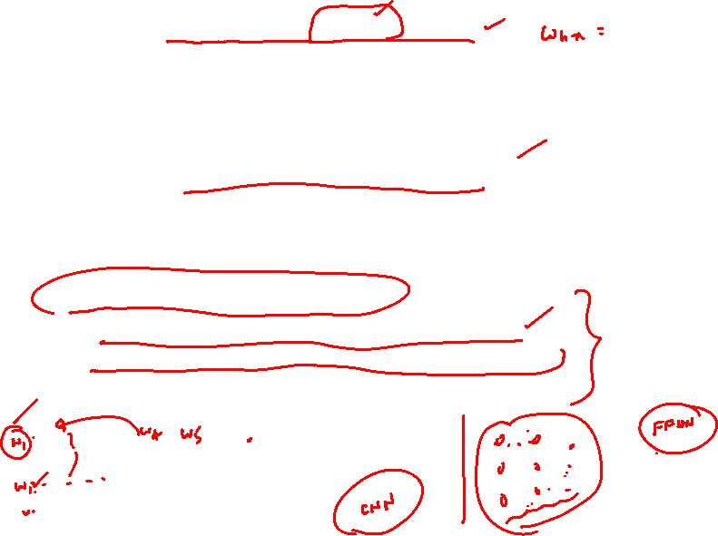
Backpropagation Through Time (BPTT)
Challenge: How to compute gradients in RNNs?
Parameters shared across all time steps
Hidden state depends on entire history
Need to backpropagate through time
Key insight: Unroll RNN into feedforward network
Apply standard backpropagation
Sum gradients from all time steps (parameter sharing)
BPTT: Backpropagation Through Time
Forward pass: compute outputs for all time steps
Backward pass: compute gradients from t = T to t = 1
Gradients flow backward through time

Slide 34
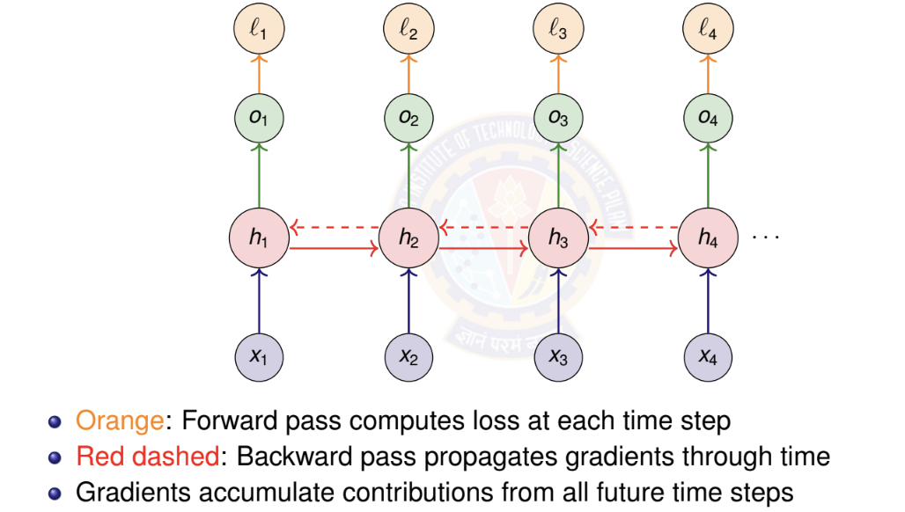

BPTT: Computational Graph

Slide 35
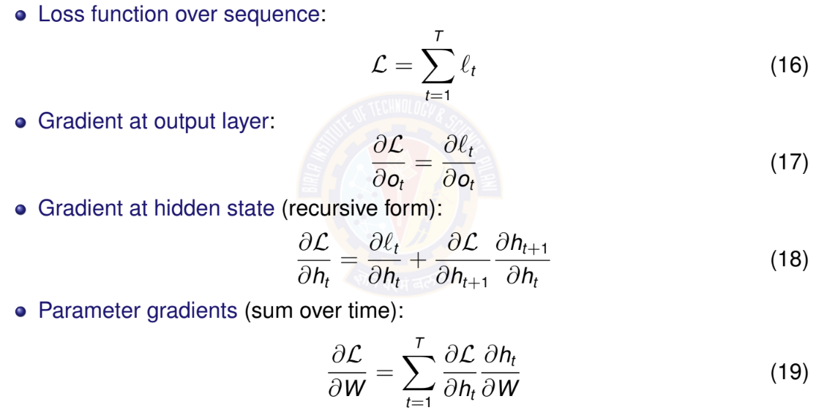
BPTT: Key Gradient Equations

Slide 36
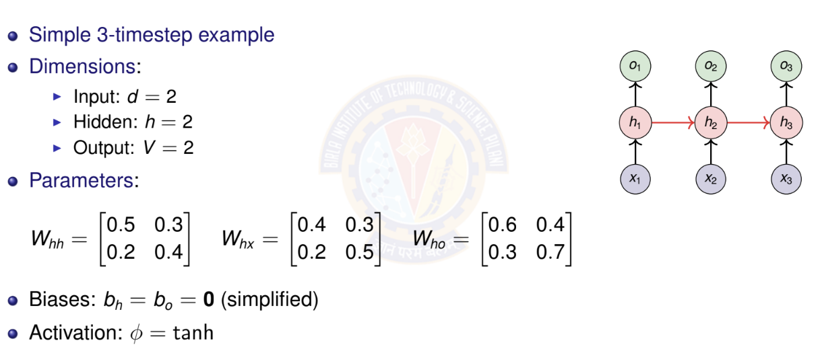
BPTT: Numerical Example Setup

Slide 37
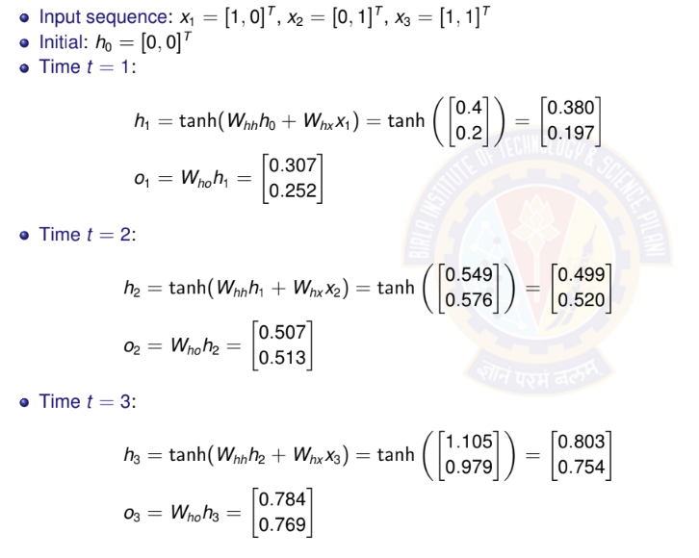
BPTT: Forward Pass

Slide 38
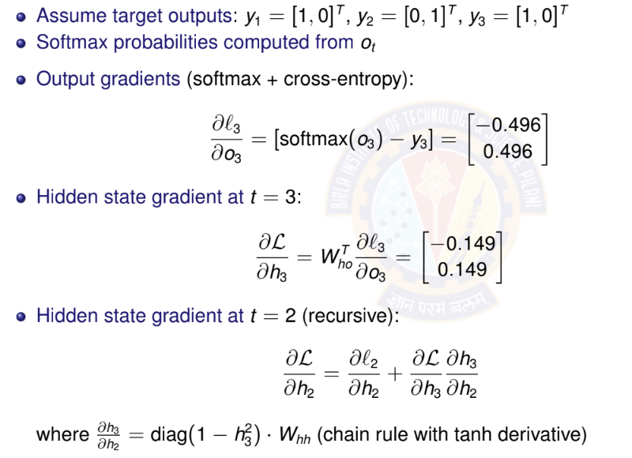
BPTT: Backward Pass

Slide 39
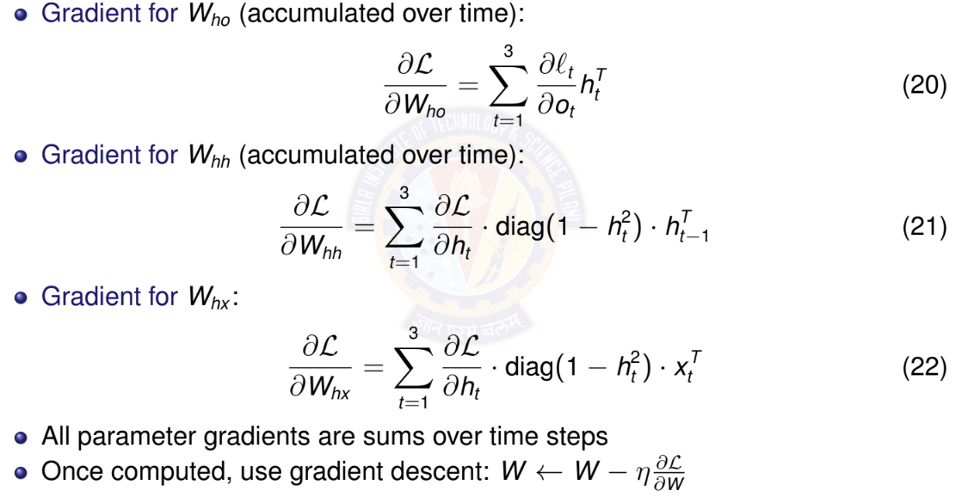
BPTT: Parameter Gradients

Slide 40
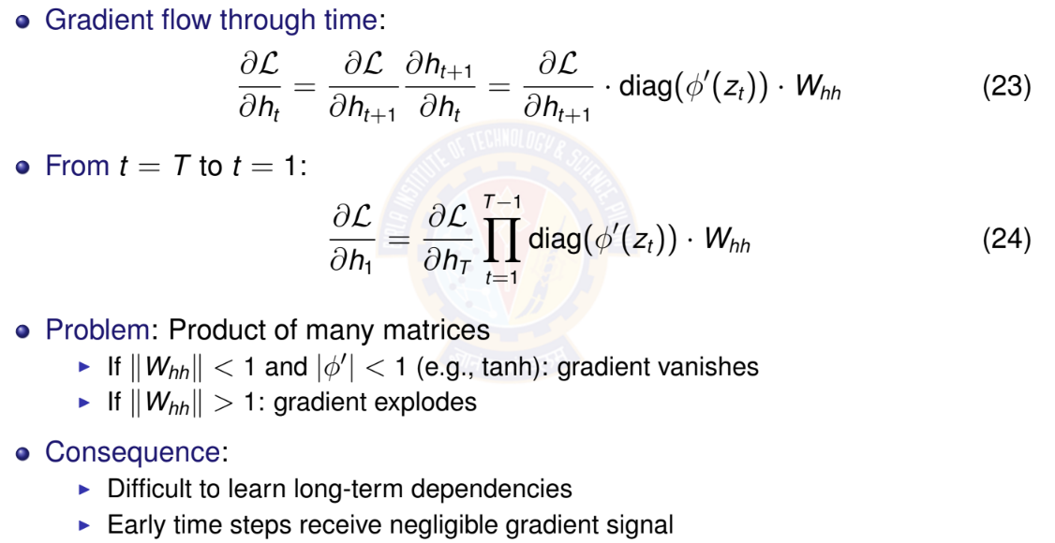
Vanishing Gradients: The Problem

Slide 41
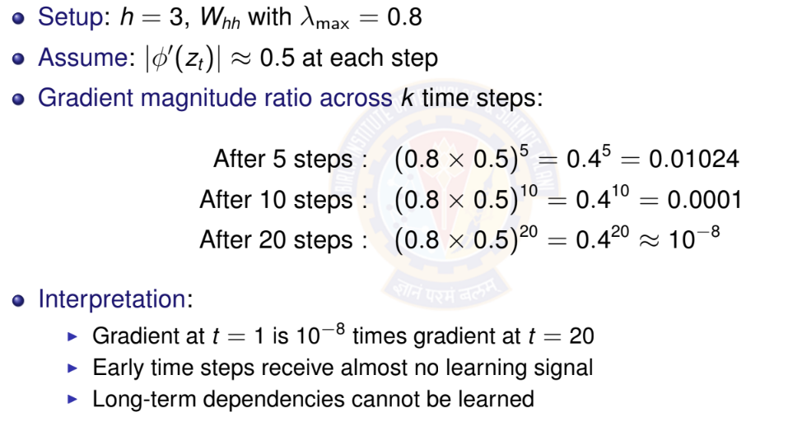
Vanishing Gradients: Numerical Example

Slide 42
Why Vanishing Gradients are Problematic?
Learning difficulty:
Parameters affecting early time steps barely update
Model cannot learn long-term patterns
Training becomes ineffective for long sequences
Example scenarios where this fails:
”I grew up in France... [50 words]... I speak fluent ”
Long-range syntactic dependencies in language
Time series with seasonal patterns (yearly cycles)
Solutions:
Better architectures: LSTM, GRU
Careful initialization
Skip connections

Slide 43
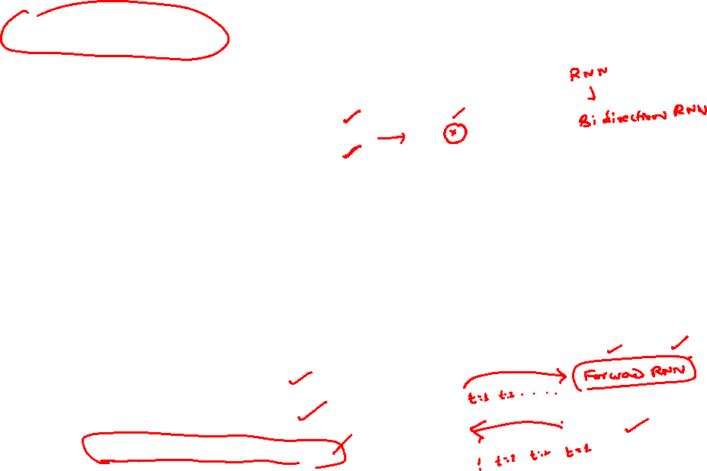
Bidirectional RNNs: Motivation
Limitation of standard RNN: Only uses past context
Predicts based on x₁, . . . , x_{t —1}
Cannot use future information
Many tasks benefit from full context:
Sentiment analysis: ”The movie was not ” (need to see ”good” or ”bad”)
Named entity recognition: ”I met Paris in Paris” (person vs city - need full context)
Speech recognition: Future phonemes help disambiguate current sound
Machine translation: Full sentence context improves translation
Key idea: Process sequence in both directions
Forward RNN: left-to-right
Backward RNN: right-to-left
Combine information from both

Slide 44
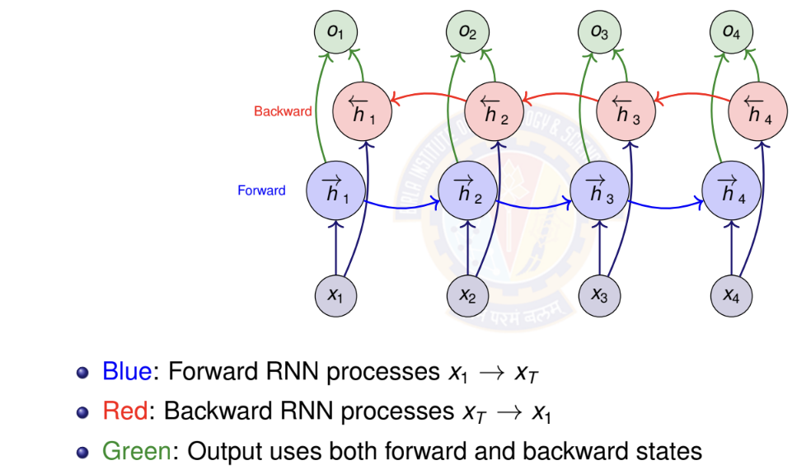
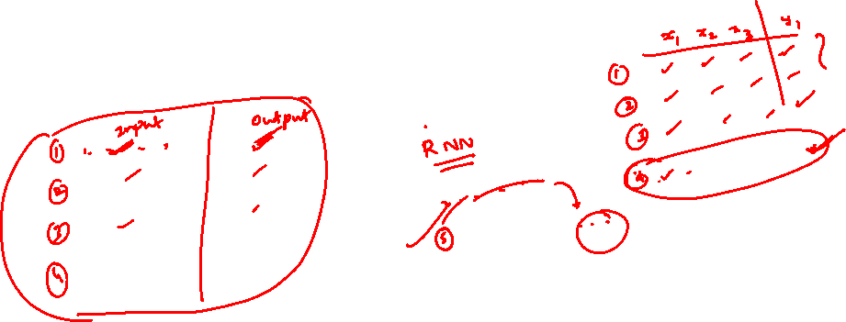
Bidirectional RNN Architecture

Slide 45
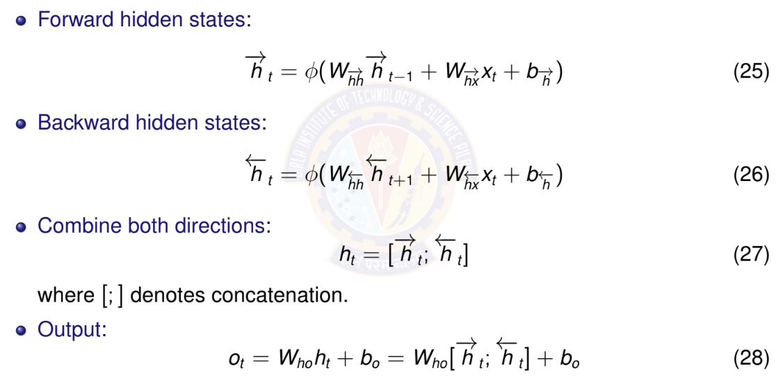
Bidirectional RNN: Mathematical Formula

Slide 46
When to Use Bidirectional RNNs
Use bidirectional RNNs when:
Entire sequence available before prediction
Task benefits from future context
Examples: text classification, named entity recognition, machine translation (encoder)
Do NOT use when:
Real-time/online prediction required
Causal modeling (future cannot influence past)
Examples: language modeling, real-time speech recognition, time series forecasting
Key limitation: Must process entire sequence
Cannot make predictions until sequence complete
Higher computational cost (two RNNs)
Not suitable for streaming applications

Slide 47
Deep (Stacked) RNNs: Motivation
Why stack RNN layers?
Single RNN layer: limited representational capacity
Deep networks learn hierarchical features
Lower layers: simple patterns
Higher layers: complex, abstract patterns
Examples of hierarchical features:
Text: characters → words → phrases → sentences
Speech: phonemes → syllables → words
Time series: short-term → medium-term → long-term trends
Empirical observation:
Deeper RNNs often outperform wider single-layer RNNs
Typical depth: 2-4 layers (diminishing returns beyond this)

Slide 48
Deep RNN: Gradient Flow Considerations
Gradient must flow through:
Time (horizontal connections within each layer)
Depth (vertical connections between layers)
Compound vanishing gradient problem:
Gradients vanish in time dimension (as in single-layer RNN)
Additional vanishing through depth
Problem is more severe than single-layer RNN
Mitigation strategies:
Use LSTM/GRU cells instead of vanilla RNN (upcoming)
Skip connections between layers (residual connections)
Careful initialization
Layer normalization
Practical limit: Typically 2-4 layers
Deeper networks harder to train
Diminishing returns beyond 4 layers

Slide 49
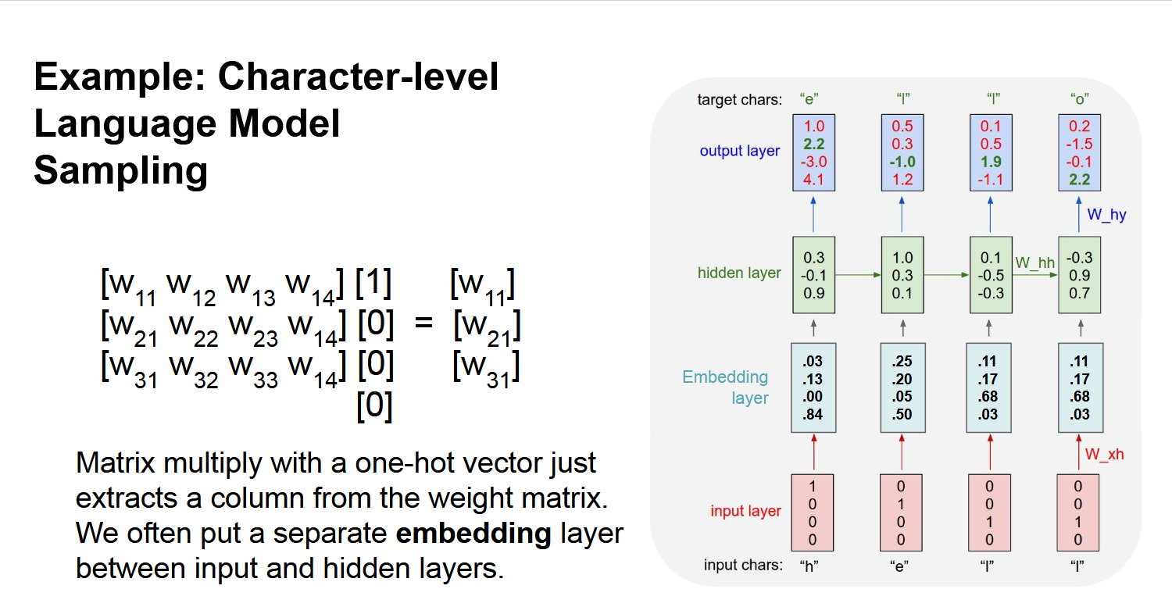
RNN - Example

Slide 50
Long term dependency example
Example:
LM task: When she tried to print her tickets, she found that the printer was out of toner. She went to the stationery store to buy more toner. It was very overpriced. After installing the toner into the printer, she finally printed her
Dependency between “tickets” on the 7th step and the target word “tickets” at the end.

Slide 51
Long Short Term Memory - LSTM
Length of a sentence is an issue with RNN
Vanishing and exploding gradient are issues
LSTM is an extension for RNN , which basically extends the memory
LSTM can read , write and delete information from its memory
LSTN will have 3 gates
i.e. input gate , forget gate and output gate

Slide 52
Long Short Term Memory - LSTM
Building block of an LSTM is a memory cell, which replaces the hidden layer of standard RNNs
LSTM unit consists of
  Cell state (C_{t}​) → Responsible for carrying long-term memory.
  Hidden state (h_{t}​) → Represents the output at each time step.
  Three gates → Forget Gate, Input Gate, and Output Gate
LSTM has many variants which include different number of gates and also different arrangement of gates
Another equally popular variant of LSTM is Gated Recurrent Unit(GRU)

Slide 53
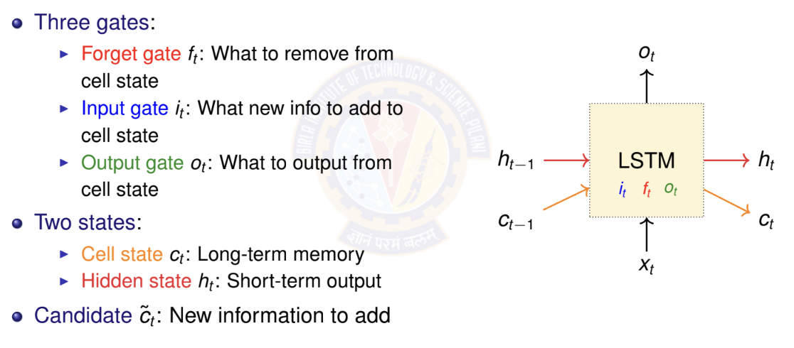
LSTM: Architecture Overview

Slide 54
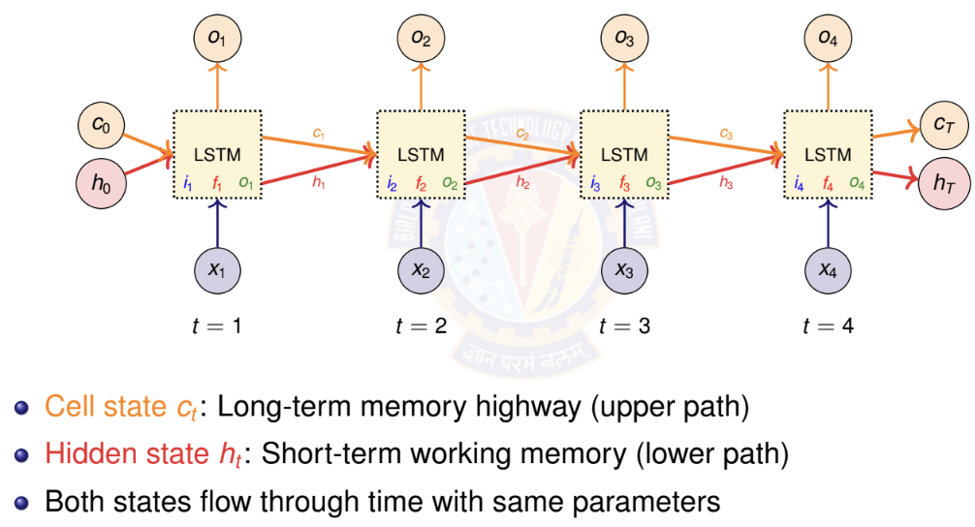
LSTM: Unrolled Architecture Across Time

Slide 55
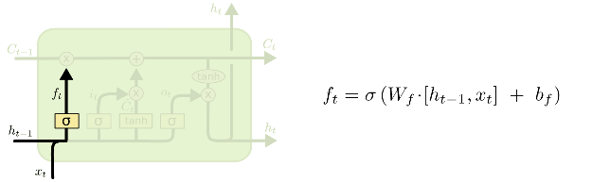





i_{t} decides what component
is to be updated.
C’_{t} provides change contents
Updating the cell state
Decide what part of the cell
state to output

Slide 56


Slide 57
i_{t} decides what component
is to be updated.
C’_{t} provides change contents

Slide 58
Updating the cell state
Decide what part of the cell
state to output

Slide 59

LSTM: Parameter Counting

Slide 60

GRU – gated recurrent unit
(more compression)
LSTM
reset gate
Update gate
It combines the forget and input into a single update gate.
It also merges the cell state and hidden state.
This is simpler than LSTM. There are many other variants too.
X,*: element-wise multiply

Slide 61


(c)GRU

Slide 62


Gated Recurrent Unit - GRU
Reset Gate r_{t}
    r_{t} ≈ 0, forgets most of h_{t−1}
    r_{t} ≈ 1, retains most of h_{t−1}
Update Gate z_{t}
    z_{t}​ ≈ 0, uses the new candidate memory
    z_{t}​ ≈ 1, keeps the old hidden state

Slide 63


Gated Recurrent Unit - GRU
Candidate Hidden State h_{t}​~
    If r_{t} is low, resets the hidden state
    If r_{t} is high, retains past memory
Final Hidden State h_{t}
    If z_{t} ​≈ 1, keeps the old state
    If z_{t}≈ 0, replaces it with new memory

Slide 64

GRU: Numerical Example - Setup

Slide 65

GRU: Numerical Example - Gates Computation

Slide 66

GRU: Numerical Example - Hidden State Update

Slide 67

GRU: Numerical Example - Final Hidden State

Slide 68
LSTM vs GRU: Comparison
Property | GRU | LSTM
Number of gates | 2 (reset, update) | 3 (forget, input, output)
Memory types | 1 (hidden state) | 2 (cell + hidden)
Parameters | 3(hd + h² + h) | 4(hd + h² + h)
Relative params | Fewer (∼ 25% less) | More
Training speed | Faster | Slower
Memory usage | Lower | Higher
Gradient flow | Good | Excellent
Long sequences | Good (50-100 steps) | Better (100+ steps)
Popularity | Increasing | Most widely used
When to use GRU: Smaller datasets, shorter sequences, faster training
When to use LSTM: Longer sequences, more data available, maximum performance needed

Slide 69
Numerical on RNN
Consider the following snippet
Model = Sequential()
Model. add(SimpleRNN(3, input _ shape= (4,5),activation=activation[0]))
Model . add(Dense(1,activation= “Sigmoid”)
Draw the architecture
Calculate total number of Parameters in this

Slide 70







Discussion 1 _Continued

Slide 71
Numerical on RNN
Consider the following code snippet and draw the corresponding architecture. And also calculate number of parameters.
Model = Sequential()​
Model. add(SimpleRNN(4, input _ shape= (4,6),activation=activation[0]))​
Model . add(Dense(1,activation= “Sigmoid”)​

Slide 72
Total number of Parameters:
RNN Layer: Wxh + Whh + bh = 4*6 + 4*4 + 4 = 44
Output Layer: Wo = 1*4 and bo: 1 1*4 + 1 = 5
Total number of parameters: 44+5 = 49

Slide 73
Numerical on RNN
Compute the outputs in each timestep and the state after timestep = 3 for the Vanilla RNN given below. Assume the biases as zeros.
X = [ 1 1 0]^{T}
W = [ 0.2 0.3 0.8]^{T}
U = [ 0.5 0.6 0.2]^{T}
V = [0.4 0.2 0.1]^{T}

Slide 74
Discussion 3
s₀ = 0
s_{t} = σ(Ux_{t} + Ws_{t−1} + b)
yˆ_{t} = g(Vs_{t} + c)
Compute the outputs in each timestep and the state after timestep = 3 for the Vanilla RNN given below. Assume the biases as zeros.
X = [ 1 1 0]^{T} W = [ 0.2 0.3 0.8]^{T} U = [ 0.5 0.6 0.2]^{T} V = [0.4 0.2 0.1]^{T}

Slide 75
Numerical on RNN
A company is trying to automate generating reports from videos of ultrasound scans. The videos of a beating heart of fetus at a particular section or slice. The report to be generated describes the heart condition and its location and any abnormalities detected. The videos are of 36 frames each. Each frame is 360 x 240 grayscale image,
Suggest suitable type of RNN to be used for this application and justify your selection.
Compute the depth of the RNN suggested
Should an LSTM or GRU or Bidirectional RNN should be used for this application. Justify your choice.

Slide 76
Numerical on RNN
A company is trying to automate generating reports from videos of ultrasound scans. The videos of a beating heart of fetus at a particular section or slice. The report to be generated describes the heart condition and its location and any abnormalities detected. The videos are of 36 frames each. Each frame is 360 x 240 grayscale image,
Suggest suitable type of RNN to be used for this application and justify your selection.
Compute the depth of the RNN suggested
Should an LSTM or GRU or Bidirectional RNN should be used for this application. Justify your choice.
Many to Many RRN has to be used. For each frame ,the position of the fetus and the condition has to output
Depth = 36,the number of frames per video
LSTM is better

Slide 77



